Slide 1

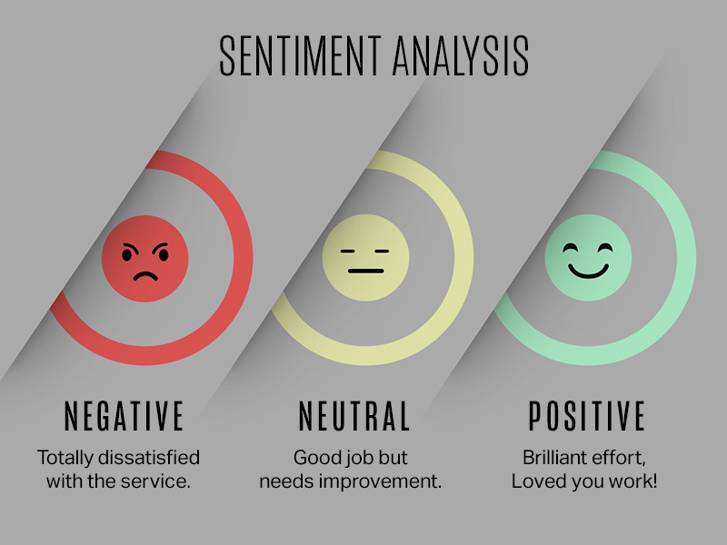
Financial News Sentiment Analysis Using Natural Language Processing (NLP)​
GT_3 Members :
Praveen Vardhan Raju
ANISH REDDY
HARISH REDDY YANNAM
JASWANTHI
ALEKHYA

Slide 2

Problem Statement
Introduction
Data Analysis and Visualization
Model Training and Validation
Future Enhancements
Challenges and Learning
Conclusion

Slide 3




Problem Statement
In the financial sector, news articles significantly impact stock prices and investor decisions. The challenge lies in the overwhelming volume of news, making it impossible for investors to manually assess whether the sentiment of a report is positive, negative, or neutral in real-time. Misinterpretation of sentiment can lead to poor financial decisions. This project aims to apply Natural Language Processing (NLP) techniques to automatically classify financial news into positive, negative, or neutral sentiment, enabling faster, data-driven decision-making for investors and businesses.

Slide 4
Introduction
In this project, we tackle the complex task of financial news sentiment analysis using advanced Natural Language Processing (NLP) techniques. By leveraging word embeddings, we capture the semantic meaning of words, enabling our models to understand the context of financial news. We incorporate both machine learning and deep learning algorithms to classify news articles into positive, negative, or neutral sentiments.
Our approach includes tuning various hyperparameters to optimize model performance and achieve higher accuracy. By combining these techniques, we aim to create a robust system that can analyze sentiment with precision, providing investors and businesses with real-time insights into market sentiment.

Slide 5

Data Analysis and Visualization
Handling null Values
Data Cleaning
Data Preprocessing
EDA

Slide 6
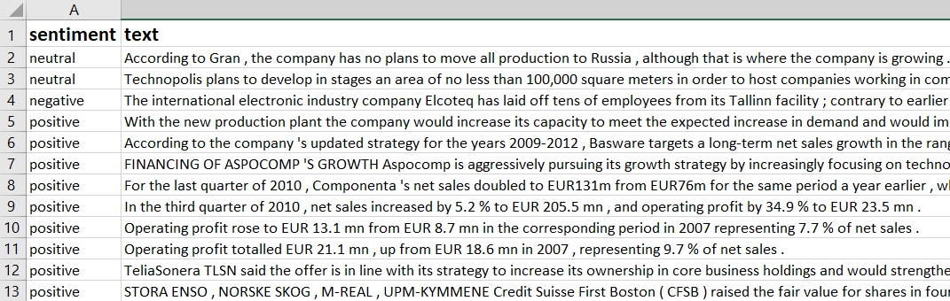
Dataset Overview:
The dataset consists of 4,845 entries and contains two columns:
Sentiment (neutral): This column represents the sentiment label of the financial news, with values such as "neutral," "negative," and "positive." It classifies the sentiment of the corresponding text in each row.
Text: The second column contains financial news or statements. These text entries are used to analyze the sentiment of the news and classify them based on their content.
No missing values are present in the dataset, indicating that both columns are fully populated.
This dataset is structured for sentiment analysis, where the goal is to classify financial news into positive, negative, or neutral sentiment. By applying Natural Language Processing (NLP) techniques, we aim to build models that can automatically predict the sentiment of new financial articles.

Slide 7
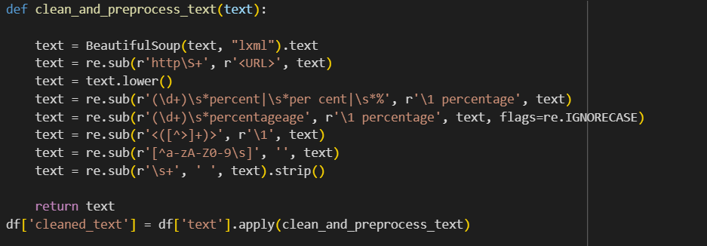
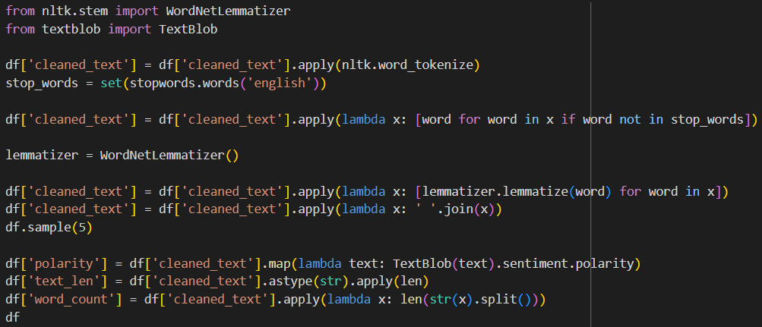
Data Preprocessing
Step 1 : Filtering unnecessary symbols
To handle data modeling
Step 2 : Applying Tokenizer, Lemmatization, Polarity for better semantic understanding
Step 3 : Removing Stopwords

Slide 8

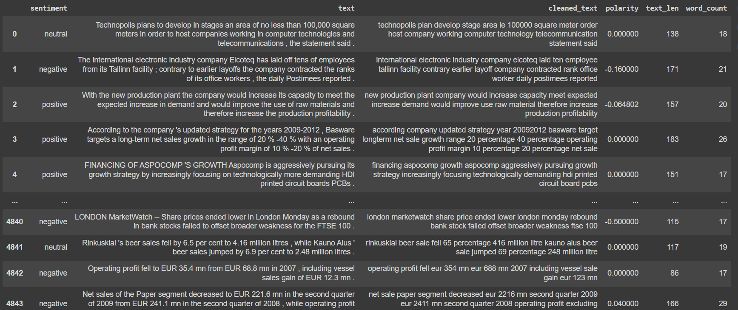




Slide 9
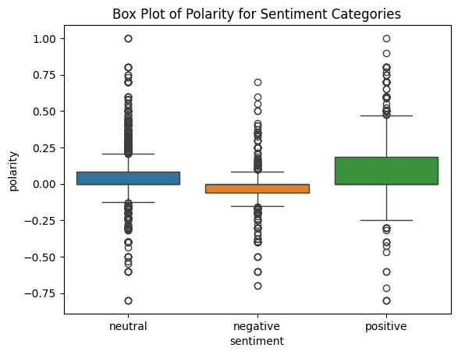
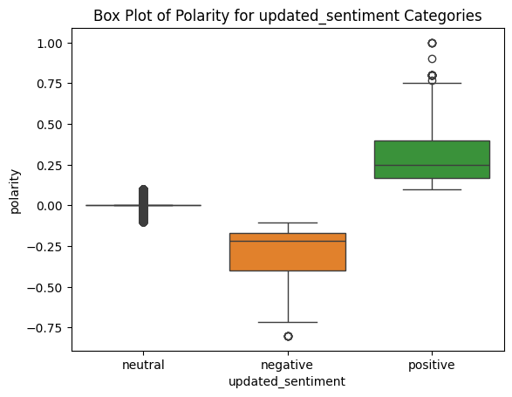
Polarity Based sentiment Classification
Before Balancing (First Image): The box plot of polarity values for each sentiment category shows that the neutral sentiment is centered around 0, while negative sentiment is skewed towards lower values, and positive sentiment towards higher values. There are visible outliers, especially in the positive and negative sentiments, indicating variability in the data.
After Balancing (Second Image): After balancing, the box plot still shows similar polarity distributions across neutral, negative, and positive sentiments. However, the number of outliers appears more evenly distributed, and the polarity ranges remain consistent, ensuring more balanced representation of sentiments.
.

Slide 10

Data visualization
These are the most common words in the Given Message data
Creating word clouds for positive, negative, and neutral sentiments, showcasing the most prominent terms after the removal of stopwords .

Slide 11
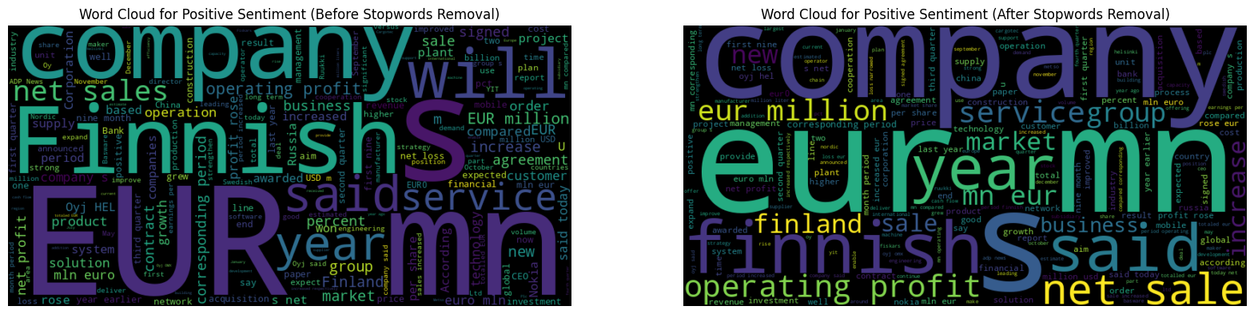
Positive Sentiment Data
Creating word clouds for Positive sentiment Data and showcasing the most prominent terms both before and after the removal of stopwords.

Slide 12
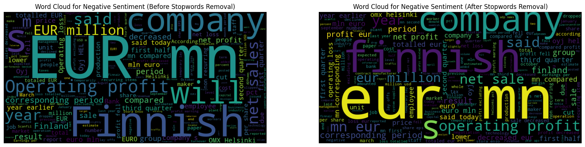
Negative Sentiment Data
Creating word clouds for Negative sentiment Data and showcasing the most prominent terms both before and after the removal of stopwords.

Slide 13
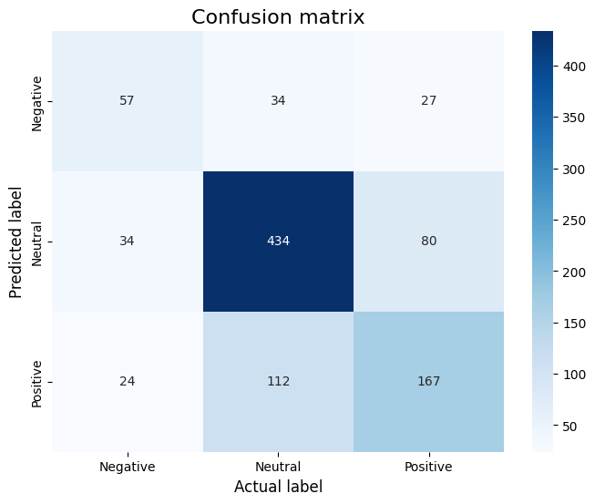
Confusion Matrix Summary (Sentiment Analysis)
Negative Class:
Correct: 57
Misclassified as Neutral: 34
Misclassified as Positive: 27
Neutral Class:
Correct: 434
Misclassified as Negative: 34
Misclassified as Positive: 80
Positive Class:
Correct: 167
Misclassified as Neutral: 112
Misclassified as Negative: 24

Slide 14
Model Training and Validation
Logistic Regression
Random Forest Classifier
Decision Tree Classifier
Xgboost Classifier
LSTM with GloVe
LSTM with Word2Vec

Slide 15
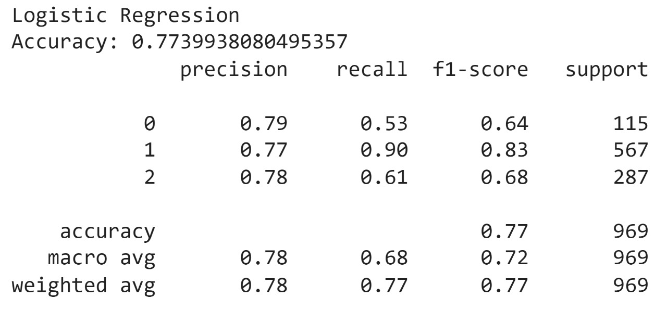
Logistic Regression
The Logistic Regression model is popular for text sentiment analysis due to its simplicity and efficiency in handling binary and multiclass tasks. It performs well in classifying sentiments, though tuning could improve detection of less frequent categories.
Model Performance:
Accuracy: 77.4%
Class 0: Precision: 0.79, Recall: 0.53
Class 1: Precision: 0.77, Recall: 0.90 (Strong performance)
Class 2: Precision: 0.78, Recall: 0.61
Macro Avg: Precision: 0.78, Recall: 0.68
Weighted Avg: Precision: 0.78, Recall: 0.77
Model Accuracy Value:

Slide 16
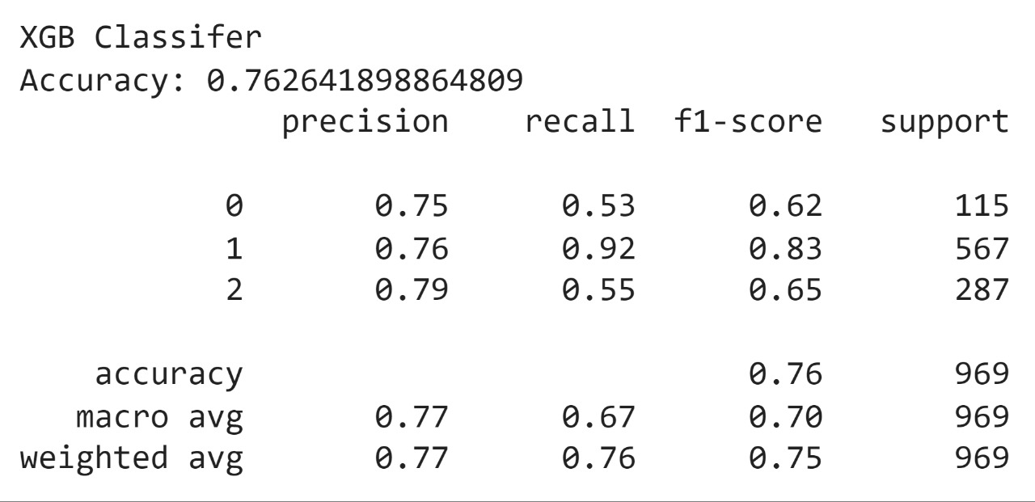
XGBoost for Financial News Sentiment Analysis
XGBoost is a powerful ensemble algorithm that improves sentiment classification by building decision trees iteratively, correcting errors at each step. This gradient boosting approach creates a more accurate and robust model for financial news sentiment analysis.
Model Performance:
Accuracy: 76.3%
Class 1: Precision: 0.76, Recall: 0.92 (Best performance)
Macro Avg: Precision: 0.77, Recall: 0.67
Key Feature:
Gradient Boosting improves accuracy by learning from errors with each tree.

Slide 17
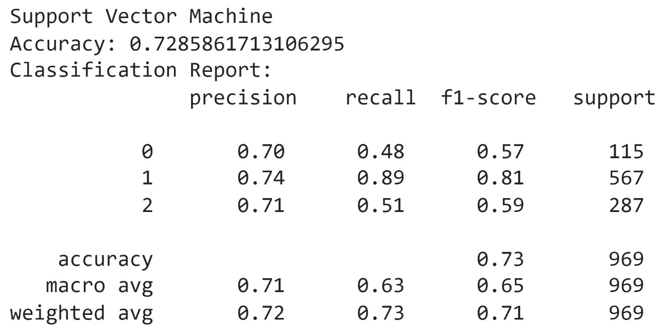
Support Vector Machine
SVM classifies financial news into positive, negative, or neutral sentiments.
It finds the optimal hyperplane to separate sentiment classes.
Captures complex word-sentiment relationships with clear separation.
Accurately predicts sentiment, providing insights into market trends.
Model Accuracy Value:

Slide 18
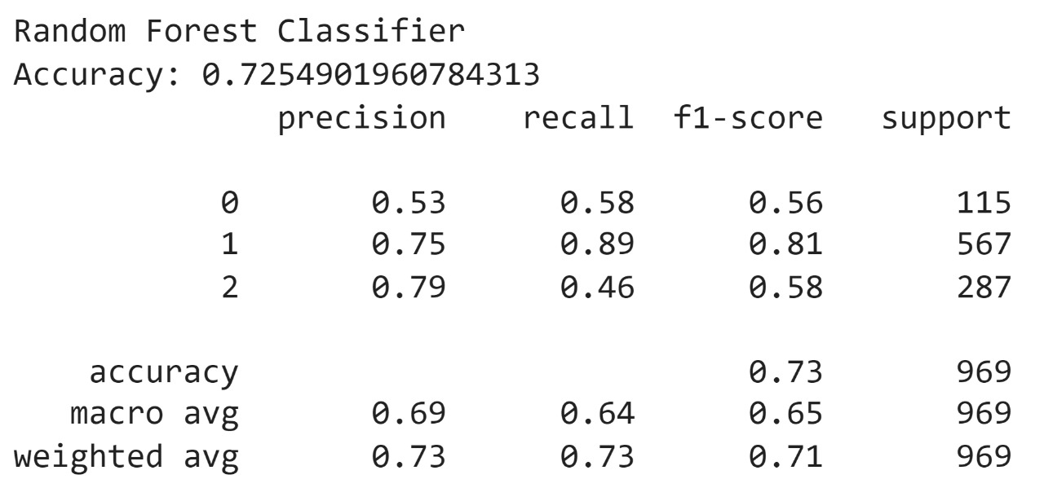
Random Forest Classifier
Random Forest builds multiple decision trees to classify financial news as positive, negative, or neutral, improving accuracy by reducing overfitting.
Model Performance:
Accuracy: 72.5%
Class 1: Precision: 0.75, Recall: 0.89 (Best performance)
Macro Avg: Precision: 0.69, Recall: 0.64
Key Features:
Ensemble Learning for enhanced accuracy
Feature Importance for identifying key words
Robustness against noise and complex data
Model Accuracy Value:

Slide 19
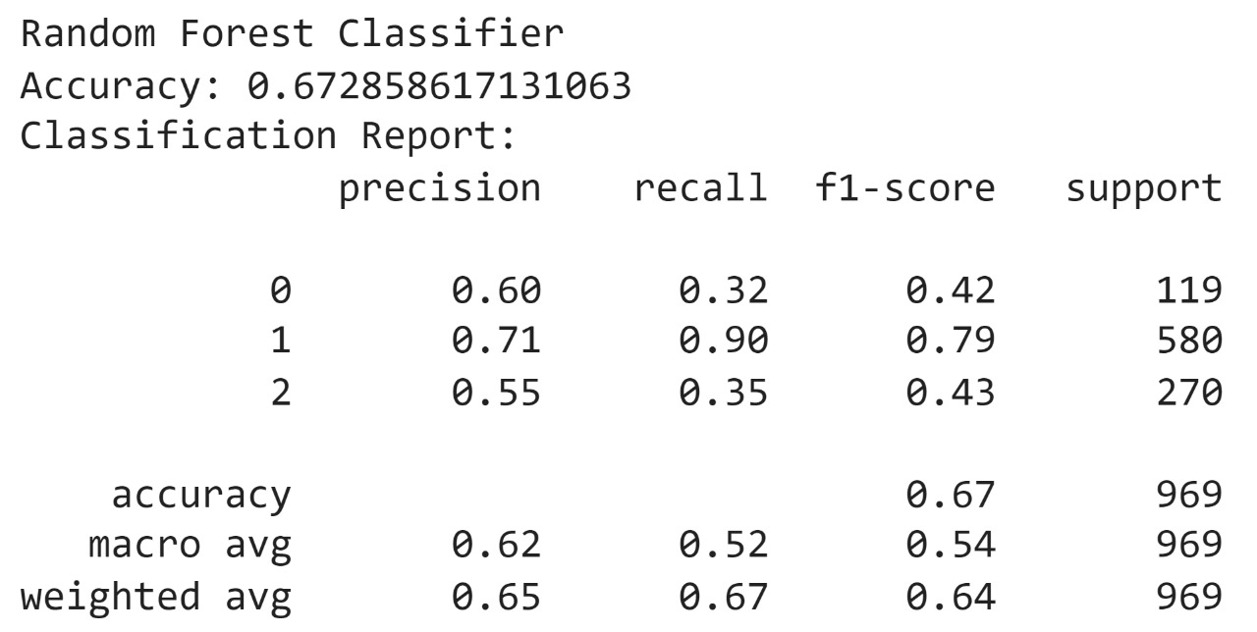
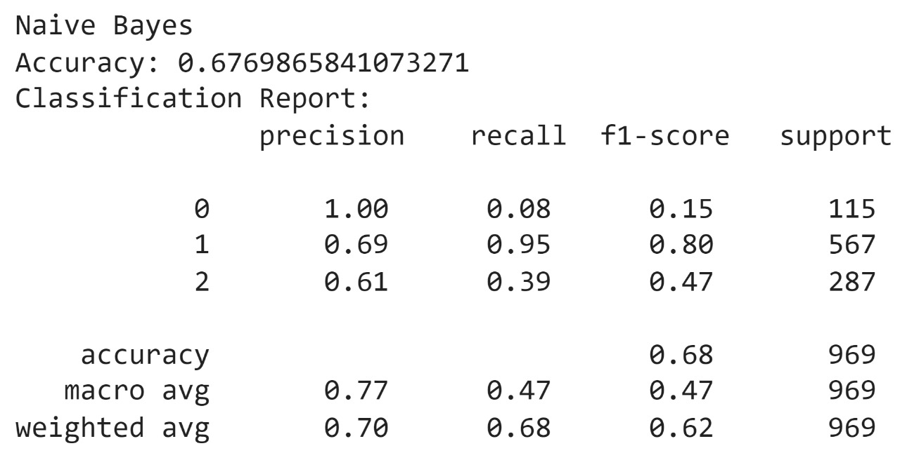
Classification Report

Slide 20
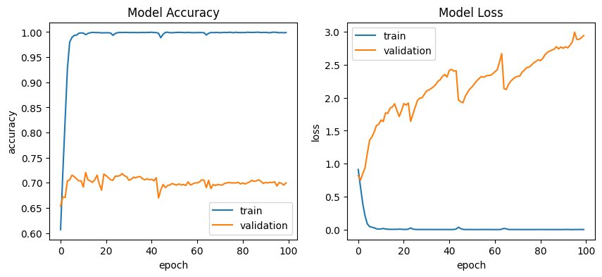
BidirectionalLSTM with Word2Vec in Sentiment Analysis:
Bidirectional LSTM neural networks capture sequential text patterns in both forward and backward directions, improving sentiment classification. When combined with Word2Vec embeddings, this model preserves word context more effectively.
Key Features:
Word2Vec: Captures semantic relationships between words.
Bidirectional LSTM: Analyzes word order in both directions for enhanced predictions.
High Accuracy: Tuning hyperparameters boosts sentiment classification performance.
Model Accuracy Value:

Slide 21

Future Enhancements
Incorporating Additional Features: Integrating more financial indicators, such as market trends or stock prices, to improve sentiment prediction accuracy.
Advanced Embedding Techniques: Experimenting with newer word embeddings like BERT or GPT for capturing deeper context and improving classification performance.
Real-time Sentiment Analysis: Implementing a real-time system for analyzing financial news sentiment, providing immediate insights for stakeholders.
Multi-lingual Support: Expanding the model to handle financial news in multiple languages for broader applicability.

Slide 22
Challenges:​
Data Preprocessing: Handling noisy and unstructured text data required significant cleaning and normalization.
Model Overfitting: Balancing complexity while avoiding overfitting, especially with deep learning models.​
Hyperparameter Tuning: Finding the optimal hyperparameters for LSTM and Word2Vec required extensive experimentation.​
​
Learning:​
​
Model Optimization: Gained insights into optimizing models using techniques like dropout and regularization.​
Text Representation: Learned how different embeddings (Word2Vec, GloVe) affect model performance.​
Real-World Application: Understood the challenges of applying sentiment analysis to financial news for actionable insights.​

Slide 23
Conclusion:
Successfully demonstrated advanced machine learning techniques for sentiment analysis of financial news.
Utilized LSTM combined with word embeddings such as Word2Vec and GloVe for accurate sentiment classification.
Achieved high accuracy in classifying sentiments as positive, negative, or neutral.
Performed careful hyperparameter tuning and thorough data preprocessing to optimize model performance.
The insights gained can help stakeholders make informed decisions based on market sentiment.
Potential for real-time sentiment analysis and future improvements to enhance decision-making processes.

Slide 24
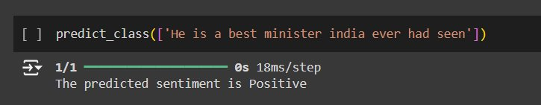
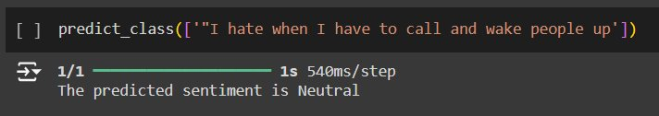
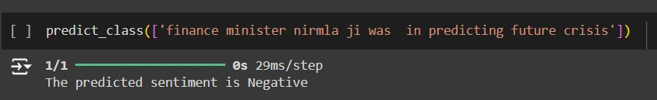
Execution

Slide 25
Thank you

